Slide 1
Seeding a Tree in a Gherkin
Setting up Complex Scenarios for Automated Tests
Paul Rohorzka - @paulroho
Software Gardener

Slide 2
What's Your Occupation?
?
Product Owner?
Architect?
Developer?
QA?
Tester?
PM?
Requirements Engineer?
Testautomation Engineer?

Slide 3
What is right?
Make it right
Is it right?
Product Owner
QA
Architect
PM
Tester
Developer
Requirements Engineer
Testautomation Engineer

Slide 4

What is right?
Make it right
Is it right?
Given
When
Then
Arrange
Act
Assert
Setup
Execute
Verify
By original uploader: Roke - Own work, CC BY-SA 3.0, https://commons.wikimedia.org/w/index.php?curid=31996181

Slide 5
What is the scenario?
Given
When
Then
Arrange
Act
Assert
Setup
Execute
Verify
What should trigger the behaviour?
How are they interconnected?
What outcome do I want to observe?

Slide 6
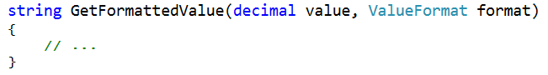
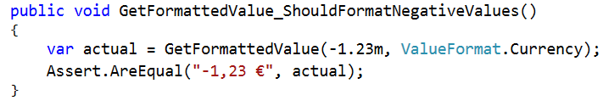
Unit Level
value
GetFormattedValue
(return)
format

Slide 7
Acceptance/End-to-End
OUT
IN

Slide 8
What is the scenario?
This talk
What should trigger the behaviour?
And a little bit
What outcome do I want to observe?

Slide 9
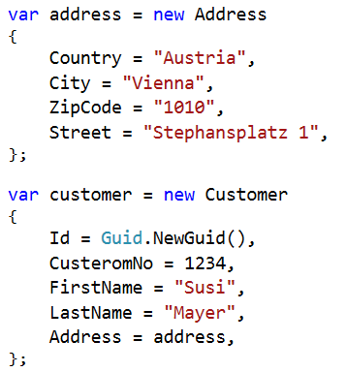
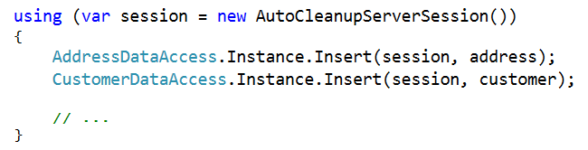
So Much Information

Slide 10
Classical Option: Setup Method
☺ Easy to get via refactoring
☹ Gets quickly out of hand (overloads, optional parameters, ...)

Slide 11
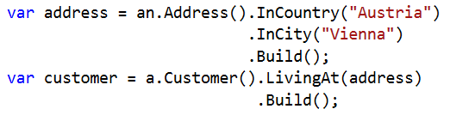
Classical Option: Builders
☺ Can be easily extended (as domain grows)
☺ IDE can help (Intellisense)
☹ Initial effort
☹ Needing multiple parts of complex structure

Slide 12
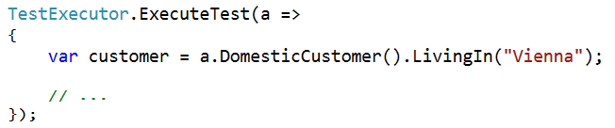
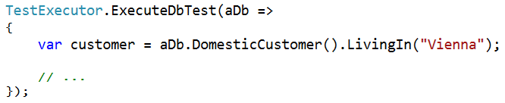
Taking Builders Further

Slide 13
Think of the Reader
Imagine
Engage
Accomplish
Write it down!
Fix the syntax!
What would we like to read?
Do we like it?
Do we still like it?
Make it work!

Slide 14

It's Showtime!
https://flic.kr/p/aN2zDe

Slide 15

Use whatever works best for the people involved
https://flic.kr/p/47xDKh

Slide 16
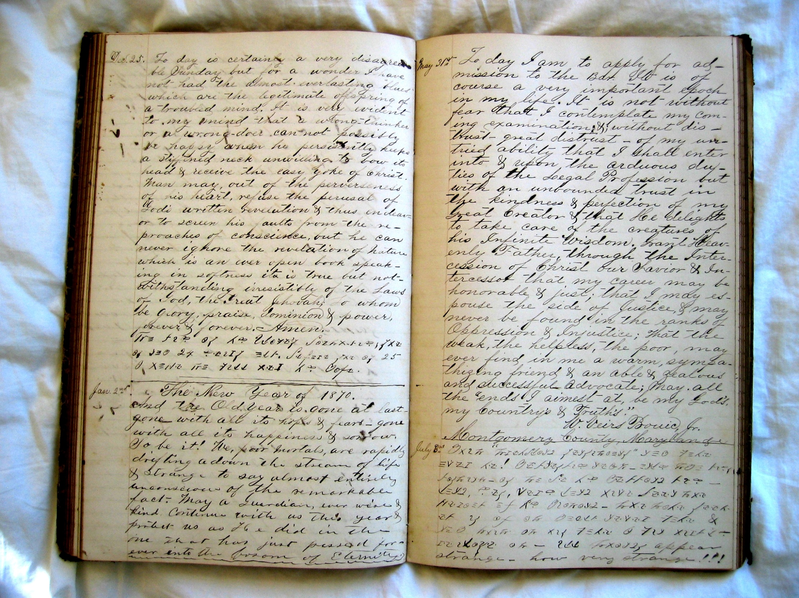
Specifying a C# API

Slide 17
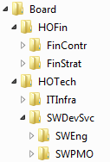
Structure of an Organization
"Org Units"

Slide 18
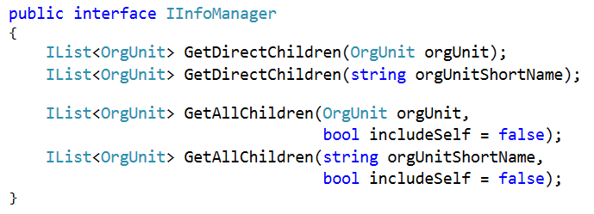
Specifying the InfoManager API
InfoManager
API
Specs
C#
Client

Slide 19
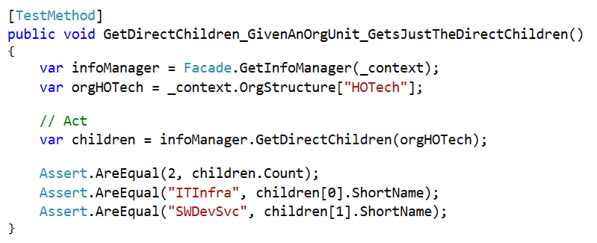
The Obvious Approach: Unit Tests

Slide 20
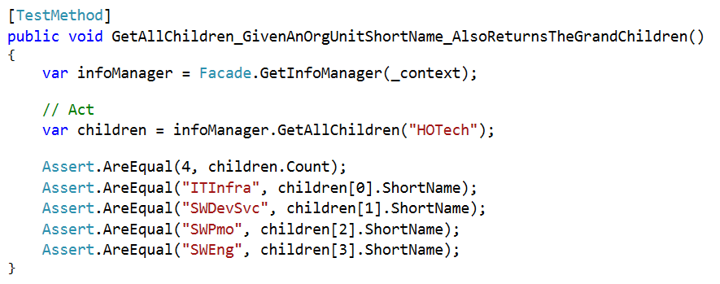
The Obvious Approach: Unit Tests

Slide 21
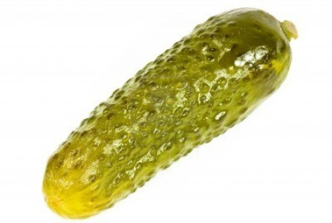
Considerations
Where is the code under test?
How let the spec stand out from other low-level unit tests?
The client app's developer is the user of your API
The interface might be subject of a conversation
It defines the behaviour (i.e. more than the static contract)
→ Give Gherkin a try!

Slide 22
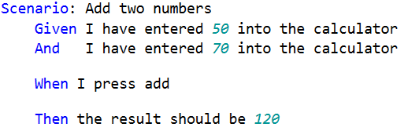
The Gherkin Language
Given
When
Then

Slide 23
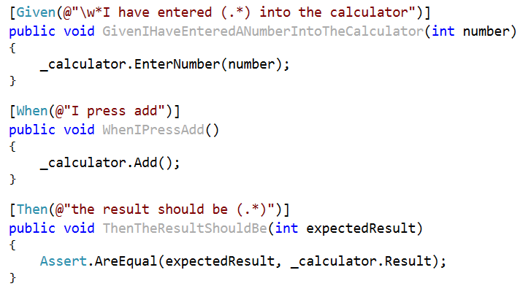
Connecting Gherkin With Code
"Step Bindings"

Slide 24
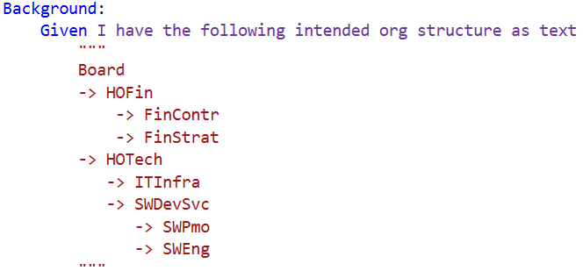
Our Take – Some Background

Slide 25
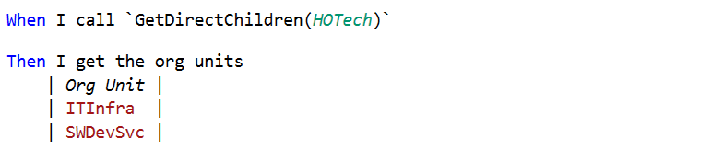
Our Take – The Specs

Slide 26
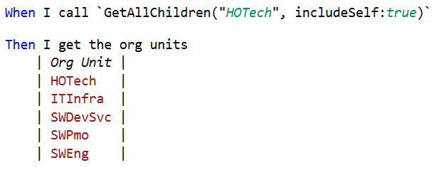
Our Take – One More

Slide 27
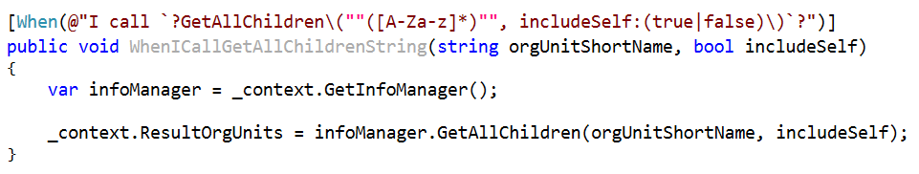
Some Downsides
Bindings might get increasingly messy
Refactoring can make the specs wrong

Slide 28
So – Challenge It!
What is the benefit?
Is it worth the effort?

Slide 29

Building a Permission Chain
https://flic.kr/p/4SxU1r

Slide 30
Introducing PERSY (PERmission SYstem)
User
m:n
Group
m:n
Position
AD-Group
6 object in chains
Each active/inactive
Ignore chain if one object is inactive

Slide 31
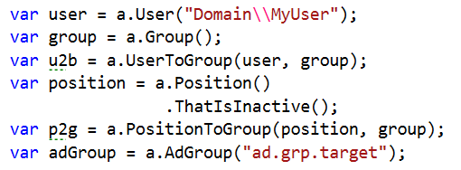
Setup in 6 one-liners?

Slide 32

Super-Entity to the rescue!
https://flic.kr/p/eXQbXV

Slide 33
Super entity PermissionChain
PermissionChain
User
m:n
Group
m:n
Position
AD-Group

Slide 34
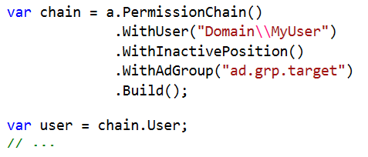
PermissionChainBuilder in Action

Slide 35

Stress your imagination!

Slide 36
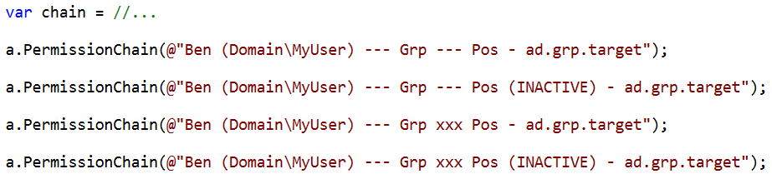
String Representation in Unit Testing Style

Slide 37
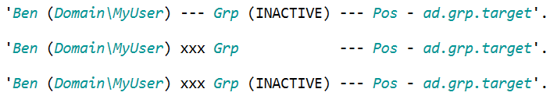
Utilizing Gherkin Style
Syntax highlighting
Variations:

Slide 38
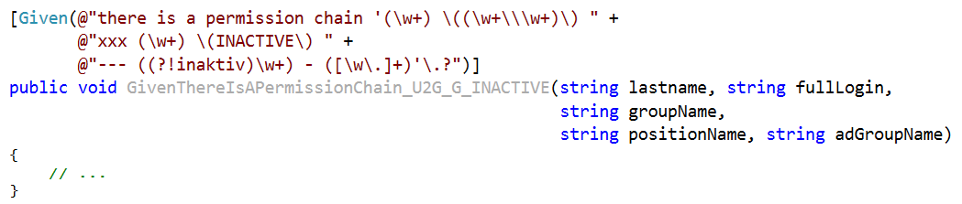
Catch
1 out of 50+!
Fragile!
→ Meta tests
Is it worth it?
Yes, if this is part of the core domain

Slide 39
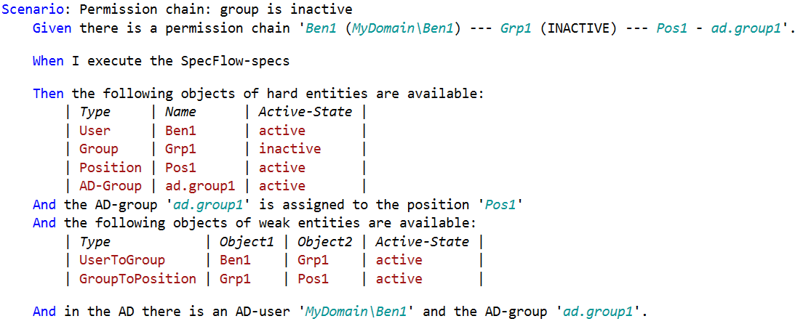
A Meta Test

Slide 40

Seeding A Tree
https://flic.kr/p/ooBmLt

Slide 41
Testing a Feature Based on a Tree Structure
"Org Units"

Slide 42
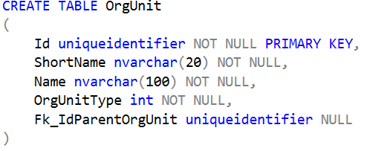
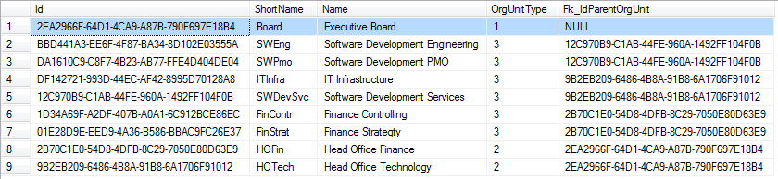
In the Database

Slide 43
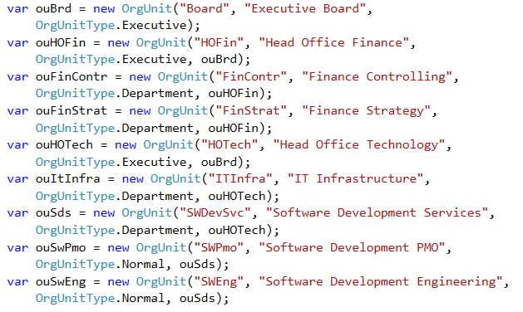
Obvious Approach: Domain Model API

Slide 44
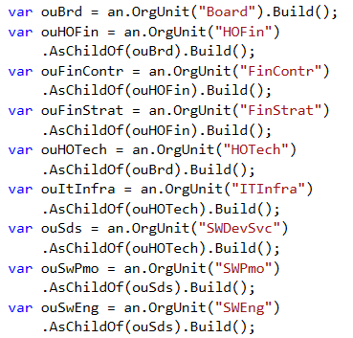
Next Attempt: Builders

Slide 45
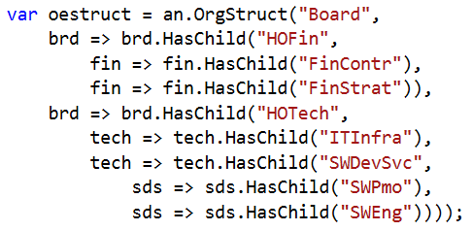
Going Meta: Meta-Builder

Slide 46
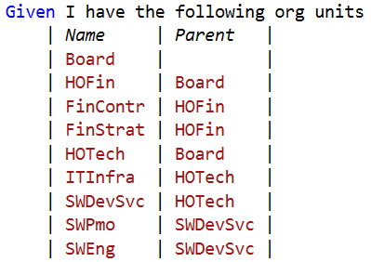
Switching to Gherkin

Slide 47
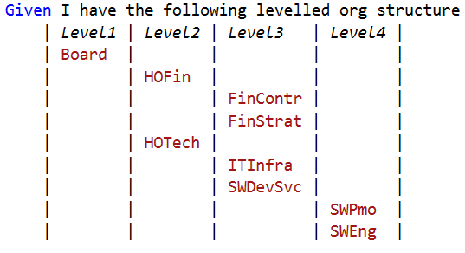
Away With the Parent References

Slide 48
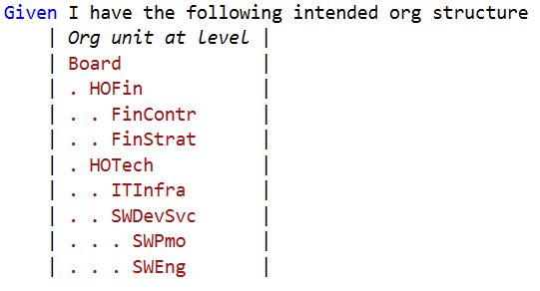
Away With That Many Columns

Slide 49
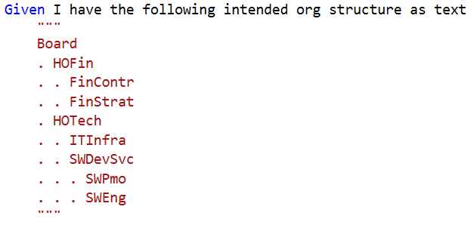
Away With the Table

Slide 50
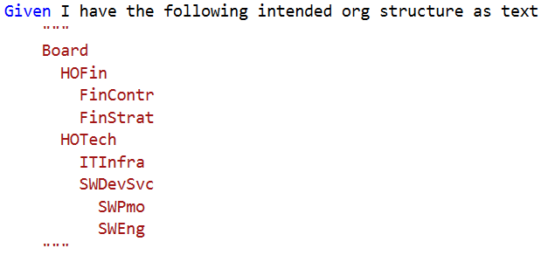
Away With the Dots

Slide 51
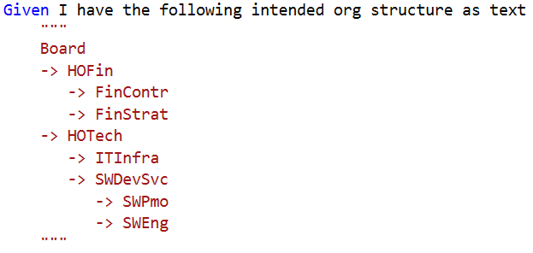
Some ASCII Art

Slide 52

Put First What You Would Love to See
Not What You Have.
By Mstyslav Chernov - Self-photographed, http://mstyslav-chernov.com/, CC BY-SA 3.0, https://commons.wikimedia.org/w/index.php?curid=28541140

Slide 53


